Slide 1


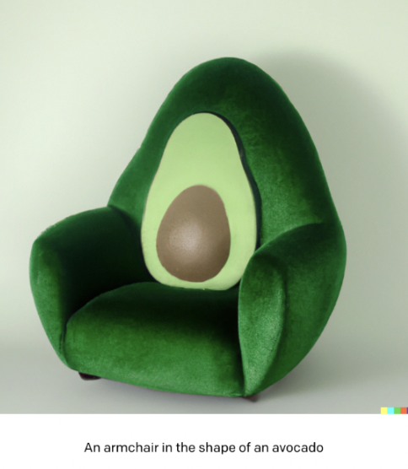
IEEE International Conference on Artificial Intelligence & Knowledge Engineering (AIKE 2023)
Prompt Recommendation for AI Art
Kapil Wanaskar
Software (Machine Learning) Co-op Intern
at Product Security Team,
Intuitive, Sunnyvale
Hyelim Yang,
Kapil Wanaskar,
Harshika Shrivastava,
Shahbaz Mansahia,
Shakshi Richhariya,
Prof. Magdalini Eirinaki

Slide 2


Introduction
Dall-E and Midjourney have reshaped digital art creation.
Picture this: "a white cat sitting on a Disney-themed window" and witnessing art spring to life. But what if we could make it even easier to choose the right "idea" for art ?
Optimizing art concept recommendations is our focus.
Our data: user IDs, ideas, and images, without ratings.
We use graph analysis and user clustering for refined suggestions.
Goal: Advance AI art prompt recommendations.
Notes:
Slide 1) Introduction
1.1) Dall-E and Midjourney have reshaped digital art creation.
The dynamic world of digital art has been transformed by AI platforms such as Dall-E and Midjourney.
Users can create stunning artworks by simply entering text prompts on these platforms.
1.2) Picture this: "a white cat sitting on a Disney-themed window" and witnessing art spring to life. But what if we could make it even easier to choose the right "idea" for art?
A prompt like "white cat sitting on a window in Disney theme" can produce beautiful and imaginative results.
The right prompts yield more desired outcomes and enhance the user experience.
1.3) Optimizing art concept recommendations is our focus.
The study's primary goal is to simplify the process of prompt selection by offering prompt recommendations.
This is a unique challenge due to the absence of explicit ratings or even implicit preference scores.
1.4) Our data: user IDs, ideas, and images, without ratings.
The available data for recommendations is limited to user ID, the prompt, and the corresponding image.
Traditional evaluation methods for recommendation systems, such as RMSE and Precision@n, are not applicable here.
1.5) We use graph analysis and user clustering for refined suggestions.
The research introduces a novel methodology that uses graph analysis and community detection algorithms to evaluate the performance of recommendation algorithms.
This approach is especially valuable in the absence of ratings or preference scores.
1.6) Goal: Advance AI art prompt recommendations.
While there's extensive research on AI art creation, this work specifically targets prompt recommendation.
It addresses a clear gap in the research landscape, emphasizing the significance of quality prompts in generating compelling artworks.

Slide 3

Challenges and Objective
Absence of explicit ratings and traditional metrics.
Limited data availability: user ID, prompt, image.
Addressing the gap in AI art creation research.
Focus on prompt recommendation.
System creation for prompt improvement.
Notes:
Slide 2) Challenges and Objective
2.1) Absence of explicit ratings and traditional metrics.
The research paper highlights the challenge of the absence of explicit ratings or even implicit preference scores in the domain of AI art prompt recommendations.
Unlike typical recommendation systems, the available data is limited to user ID, their prompt, and the respective image.
Traditional metrics like RMSE, Precision@n, etc., cannot be used to evaluate prompt recommendation algorithms.
2.2) Limited data availability: user ID, prompt, image.
The data available for making recommendations is restricted to three main attributes: user ID, the prompt entered by the user, and the generated image.
This limited data availability poses challenges in creating effective recommendation systems.
2.3) Addressing the gap in AI art creation research.
While there is significant research on AI art creation, this work specifically focuses on prompt recommendation.
The study aims to address a clear gap in the research landscape by emphasizing the importance of quality prompts in generating compelling artworks.
2.4) Focus on prompt recommendation.
The primary objective of the research is to make the process of prompt selection easier by offering prompt recommendations to users.
The study delves into various methodologies for generating prompt recommendations, including text embeddings, ensemble models, and more.
2.5) System creation for prompt improvement.
The research introduces a system designed to help users improve the AI-based image generation process.
By providing pertinent prompt ideas, the system aims to enhance user experience and generate more relevant and accurate artistic outcomes.

Slide 4
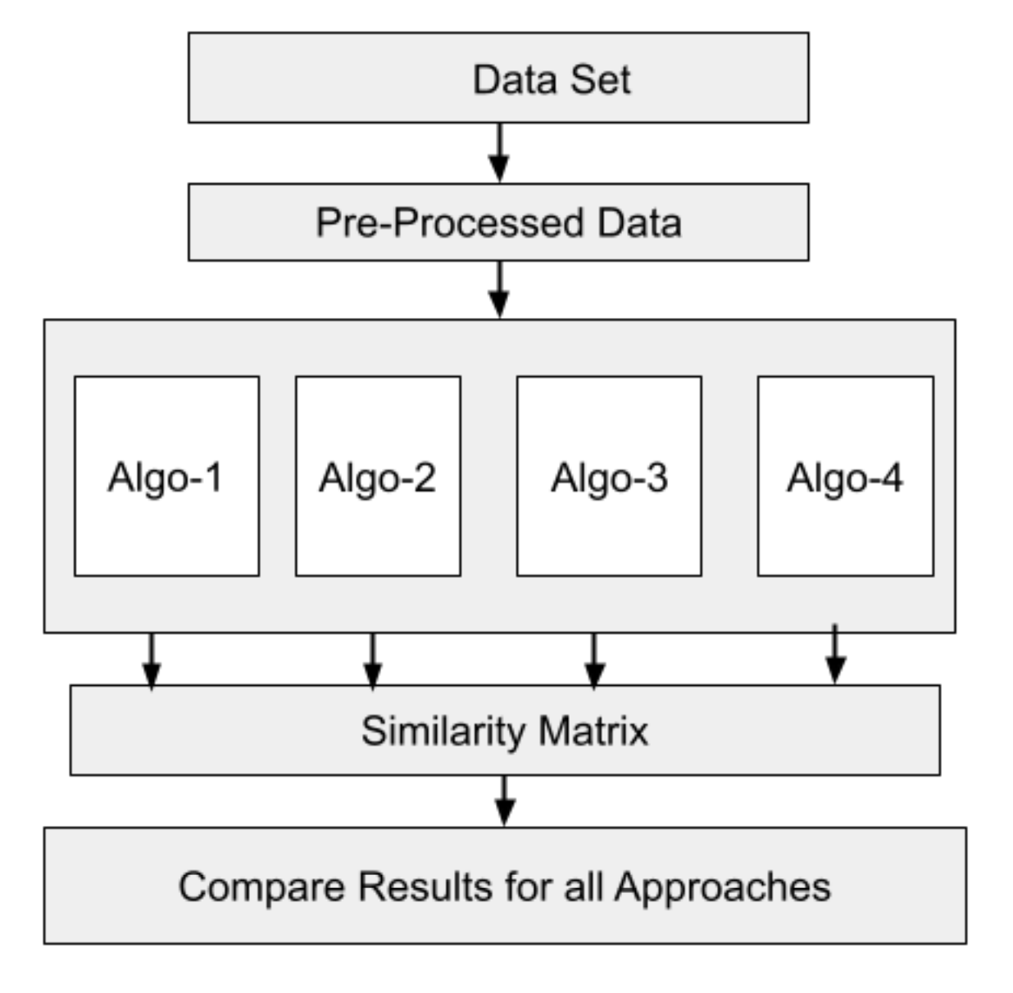
System Design & Methodologies
Architecture designed for flexibility.
Four main algorithms: Text embeddings, Ensemble models, Hybrid approach, Object detection.
Role of text embeddings and image feature extraction.
Object detection using YOLOv4.
Versatility and adaptability of the system.
Notes:
Slide 3) System Design & Methodologies
3.1) Architecture designed for flexibility.
The system's architecture is crafted for adaptability, allowing for side-by-side comparison of various methodologies.
3.2) Four main algorithms: Text embeddings, Ensemble models, Hybrid approach, Object detection.
Text embeddings: Efficiently captures and quantifies semantic relationships in textual prompts.
Ensemble models: A multi-modal approach that considers both textual and visual elements.
Hybrid approach: Combines text and image embeddings, supplemented by user cluster formation-based recommendations.
Object detection: Uses YOLOv4 for image feature extraction without relying on prompts.
3.3) Role of text embeddings and image feature extraction.
Text embeddings, like TF-IDF, capture the essence of textual prompts.
Image embeddings, such as those from the InceptionV3 model, represent the visual aspects of the AI-generated art.
3.4) Object detection using YOLOv4.
YOLOv4 is utilized to detect objects from the default common objects in context (COCO) classes.
This enhances the dataset by providing additional features for recommendation.
3.5) Versatility and adaptability of the system.
The system is designed to cater to diverse user inputs and deliver a satisfying user experience.
The combination of different approaches ensures the generation of desired and accurate artistic outcomes.
3.6) Challenges faced in Yolo: However, we faced difficulties with the YOLO model which
underperformed and required time-consuming adjustments to
store data in text format and handle type casting issues.
It struggled to detect objects in art-related data, often miscategorizing or mis-detecting objects.
Dense graphs required high performance hardware to visualize and process

Slide 5
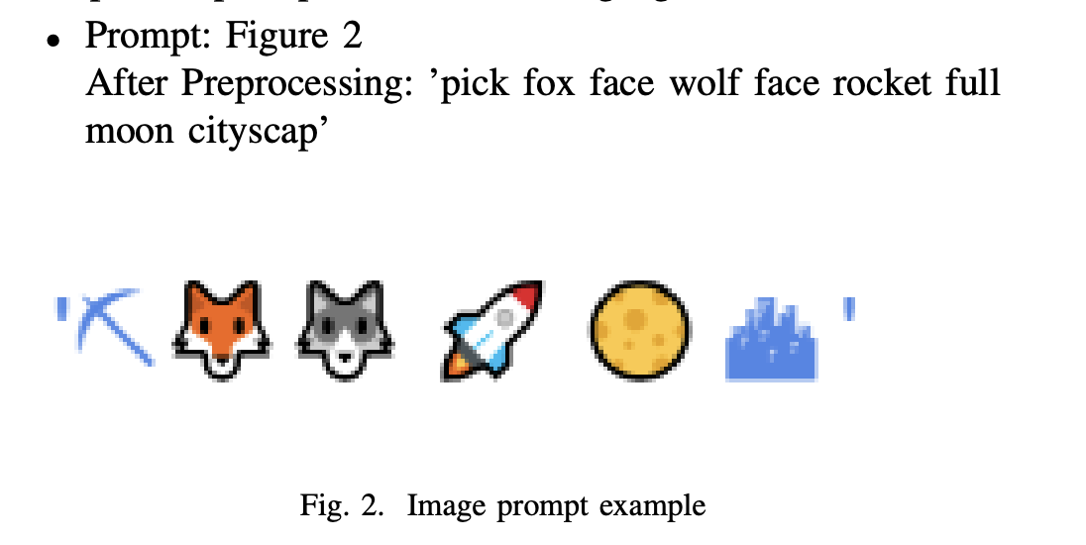
Dataset & Preprocessing
Dataset: Subset of Diffusion DB, generated in August 2022.
Features: Image, Prompt, User name.
Preprocessing: Stopwords removal, Emoji removal, Stemming.
Example after preprocessing: "the pope's hard rock band, with instruments" to "pope hard rock band instrument."
Importance of preprocessing in refining data.
Notes:
Slide 4: Dataset & Preprocessing
4.1) Dataset: Subset of Diffusion DB, generated in August 2022.
The research utilized a subset of the DiffusionDB dataset.
Initial experimentation began with 5,000 prompts.
4.2) Features: Image, Prompt, User name.
The dataset contains three main features:
Image: The AI-generated art image.
Prompt: The text string used to produce that image.
User name: The identifier of the user who entered the prompt.
4.3) Preprocessing: Stopwords removal, Emoji removal, Stemming.
The NLTK library's stopwords module was used to eliminate common stopwords.
Emojis were removed using the Emoji dictionary.
The Porter stemming algorithm from the NLTK library was employed to reduce words to their root form.
4.4) Example after preprocessing: "the pope's hard rock band, with instruments" to "pope hard rock band instrument."
This demonstrates the effectiveness of preprocessing in simplifying and refining the prompt data.
4.5) Importance of preprocessing in refining data.
Preprocessing is crucial as it cleans and structures the data, making it more suitable for analysis and recommendation.
It ensures that the data is consistent and devoid of unnecessary or redundant information, leading to more accurate recommendations.

Slide 6
Algorithm-1
Goal: Given a prompt, recommend similar prompts in the dataset
without any state-of-art embedding methods
TfidVectorizer
CounterVectorizer
- 6553 features
ex) zuckerberg, abel, etc
- No min-max normalization
- 6553 features
- Same features with TfidVectorizer
- min-max normalization
Pros:
Recognizable features
→ better interpretability
Cons:
Limitation on capturing hidden meaning in a prompt
Ignore the context of a prompt
Calculate
Cosine similarity
= Sim_{TfidVec}
Calculate
Cosine similarity
= Sim_{CounterVec}
0.5(Sim_{TfidVec}) + 0.5(Sim_{CounterVec})
Notes:
Slide 5: Algorithm-1
5.1) Goal: Given a prompt, recommend similar prompts in the dataset without any state-of-art embedding methods.
The algorithm is designed to provide prompt recommendations based on the input prompt.
It does not rely on advanced embedding techniques but utilizes traditional text vectorization methods.
5.2) TfidVectorizer
Extracts features from the text data based on the importance of a word in a document relative to a collection of documents.
Resulted in 6553 features such as 'zuckerberg', 'abel', etc.
No min-max normalization was applied to the TF-IDF vectors.
5.3) CounterVectorizer
Represents text data based on the frequency of words, disregarding the order (bag-of-words representation).
Also resulted in 6553 features, which are the same as those extracted by the TfidVectorizer.
Min-max normalization was applied to the Count Vectorization vectors.
5.4) Ensemble approach
An ensemble method was used to combine the results of the two vectorizers.
The final similarity score is given by: ensemble = 0.5(SimTfidVec) + 0.5(SimCounterVec).
This approach aims to leverage the strengths of both vectorization methods.
5.5) Pros: Recognizable features → better interpretability
The features extracted are recognizable and can be easily interpreted.
This makes the results more understandable and relatable to users.
5.6) Cons: Limitation on capturing hidden meaning in a prompt & Ignore the context of a prompt
The algorithm might not capture the deeper, hidden meanings or nuances in prompts.
It treats words individually and might ignore the overall context or sentiment of a prompt.

Slide 7
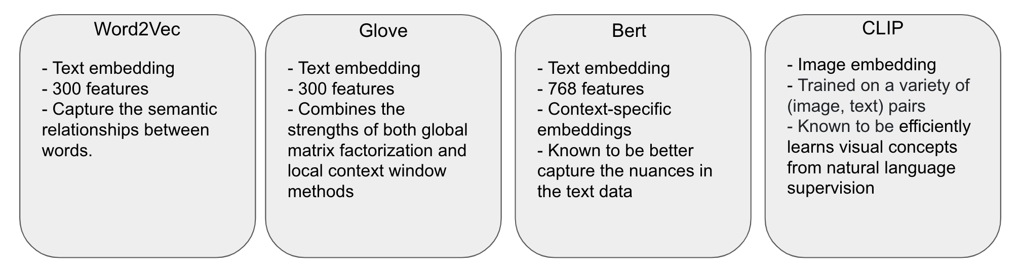
Algorithm-2 (Ensemble Models)
Deep dive into embeddings: Word2Vec, GloVe, BERT, CLIP.
Representation of words and ideas.
Differences in suggesting art prompts.
Importance of the right tool for art suggestions.
Insights from experimental evaluation.
Notes:
Slide 6) Algorithm-2 (Ensemble Models)
6.1) Deep dive into embeddings: Word2Vec, GloVe, BERT, CLIP.
Algorithm-2 delves deeper into various embedding techniques to understand the connection between text prompts and AI-generated images.
Different embeddings offer unique ways to represent words and ideas, capturing the essence of prompts.
6.2) Representation of words and ideas.
Word2Vec: Groups words with similar meanings.
GloVe: Focuses on words that often appear together.
BERT: Understands the broader context of a sentence.
CLIP: Can comprehend both images and words, making it versatile.
6.3) Differences in suggesting art prompts.
Word2Vec and GloVe: Effective for clear and simple art ideas as they find prompts that sound similar.
BERT: Excels when the prompt is story-based or references famous sayings, capturing the entire concept.
CLIP: Matches prompts with art that can be detailed or abstract, understanding both visual and textual elements.
6.4) Importance of the right tool for art suggestions.
Different embedding methods provide varied suggestions.
The choice of embedding can significantly influence the quality and relevance of art prompt recommendations.
6.5) Insights from experimental evaluation.
The experimental evaluation revealed the strengths and limitations of each embedding method.
The results emphasize the need to select the appropriate embedding technique based on the desired outcome and the nature of the art prompt.

Slide 8
Algorithm-3
Goal: Leveraging both text and image embeddings
Prompt-to-prompt recommendation
Recommendation based on image
User-based recommendation
- Input: Text embeddings from TFIDF + Image embeddings from Inception V3.
- Cosine similarity to find similar prompts based on query prompt ID.
- Input: Image embeddings from ResNet and Inception v3
- Cosine similarity to find similar prompts based on query image.
- Forming Clusters using K-means algorithm of users with similar artistic interests (based on prompt tried by user)
-Recommending prompt based on similar user in cluster.
Pros:
Able to recommend relevant prompts and images. AI generation model can give different images for same prompt, good to use (Prompt+images)
Cons:
High computational resources required.
Notes:
Slide 7) Algorithm-3
7.1) Goal: Leveraging both text and image embeddings
The algorithm aims to utilize both text and image embeddings to provide more comprehensive recommendations.
It combines:
Prompt-to-prompt recommendation: Based on the similarity of text prompts.
Recommendation based on image: Based on the similarity of AI-generated images.
User-based recommendation: Based on user behavior and preferences.
7.2) Prompt-to-prompt recommendation:
Input: Uses text embeddings derived from TFIDF and image embeddings from Inception V3.
Employs cosine similarity to identify prompts similar to the query prompt ID.
7.3) Recommendation based on image:
Input: Utilizes image embeddings from both ResNet and Inception v3.
Uses cosine similarity to find prompts similar to the query image.
7.4) User-based recommendation:
Forms clusters of users with similar artistic interests using the K-means algorithm. This is based on the prompts tried by the user.
Recommends prompts based on similar users within the same cluster.
7.5) Pros:
Capable of recommending relevant prompts and images. Given that the AI generation model can produce different images for the same prompt, it's beneficial to use both prompts and images for recommendations.
7.6) Cons:
Requires high computational resources, which can be a limitation for real-time recommendations or when dealing with large datasets.

Slide 9
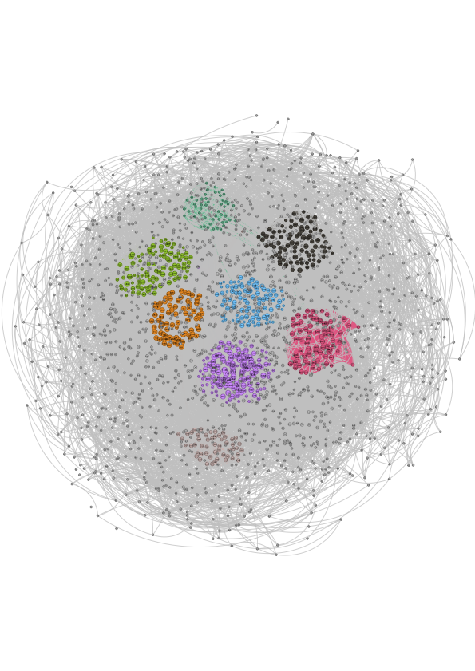
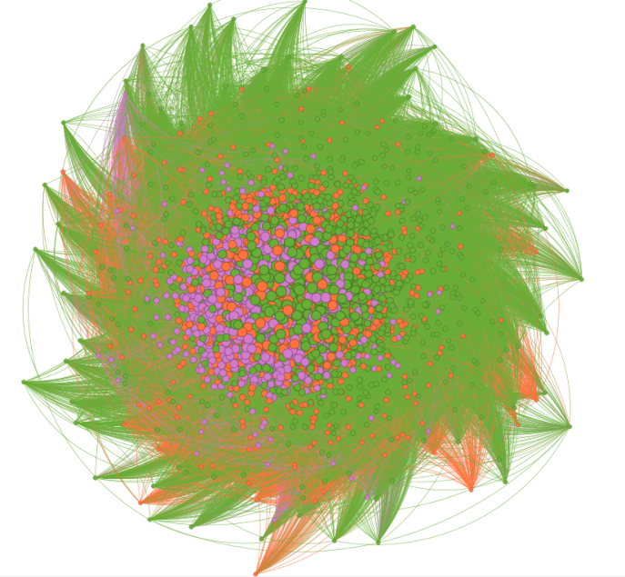
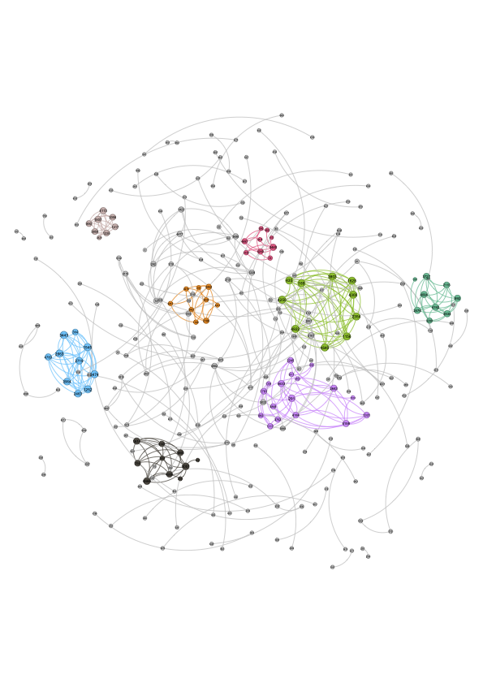
Evaluation: Comparison between algorithms
Algorithm 1
Algorithm 2
Algorithm 3
Graph
after the community detection
# of nodes | 3587 | 4940 | 282
# of edges | 29020 | 7,255,901 | 391
Avg weighted degree | 13.53 | 2,204.88 | 2.24
Graph density | 0.005 | 0.595 | 0.01
Modularity | 0.943 | 0.07 | 0.941
The number of communities | 607 | 4 | 88
Notes:
Slide 8) Evaluation: Comparison between algorithms
# of nodes:
Represents the number of unique entities (in this context, prompts) in the graph.
Algorithm1: 3587 nodes suggest that there are 3587 unique prompts.
Algorithm2: 4940 nodes indicate a larger set of unique prompts.
Algorithm3: 282 nodes suggest a much smaller set of unique prompts.
# of edges:
Represents the connections or relationships between the nodes.
Algorithm1: 29020 edges indicate the number of relationships between the 3587 prompts.
Algorithm2: 7255901 edges suggest a dense network of relationships among the 4940 prompts.
Algorithm3: 391 edges indicate fewer relationships among the 282 prompts.
Avg weighted degree:
Represents the average number of connections each node has, weighted by the strength of the connections.
Algorithm1: An average of 13.53 suggests that each prompt is related to around 13 other prompts.
Algorithm2: An average of 2204.88 indicates a much denser connectivity.
Algorithm3: An average of 2.24 suggests sparse connectivity.
Graph density:
Indicates how many edges are in the graph compared to the maximum possible number of edges.
Algorithm1: A density of 0.005 suggests a sparse graph.
Algorithm2: A density of 0.595 indicates a much denser graph.
Algorithm3: A density of 0.01 is sparse, similar to Algorithm1.
Modularity:
Measures the strength of division of a network into modules. Values close to 1 indicate strong community structure.
Algorithm1: A modularity of 0.943 suggests a strong community structure.
Algorithm2: A modularity of 0.07 indicates weak community structure.
Algorithm3: A modularity of 0.941 is similar to Algorithm1, indicating strong community structure.
The number of communities:
Represents the number of distinct groups or clusters in the graph.
Algorithm1: 607 communities suggest a diverse set of prompt groups.
Algorithm2: Only 4 communities indicate fewer distinct groups.
Algorithm3: 88 communities suggest a moderate number of distinct prompt groups.
Interpretation:
Algorithm1 has a diverse set of prompts with moderate connectivity and strong community structure.
Algorithm2 has the densest connectivity among prompts but lacks a strong community structure.
Algorithm3 focuses on a smaller set of prompts with sparse connectivity but maintains a strong community structure.

Slide 10
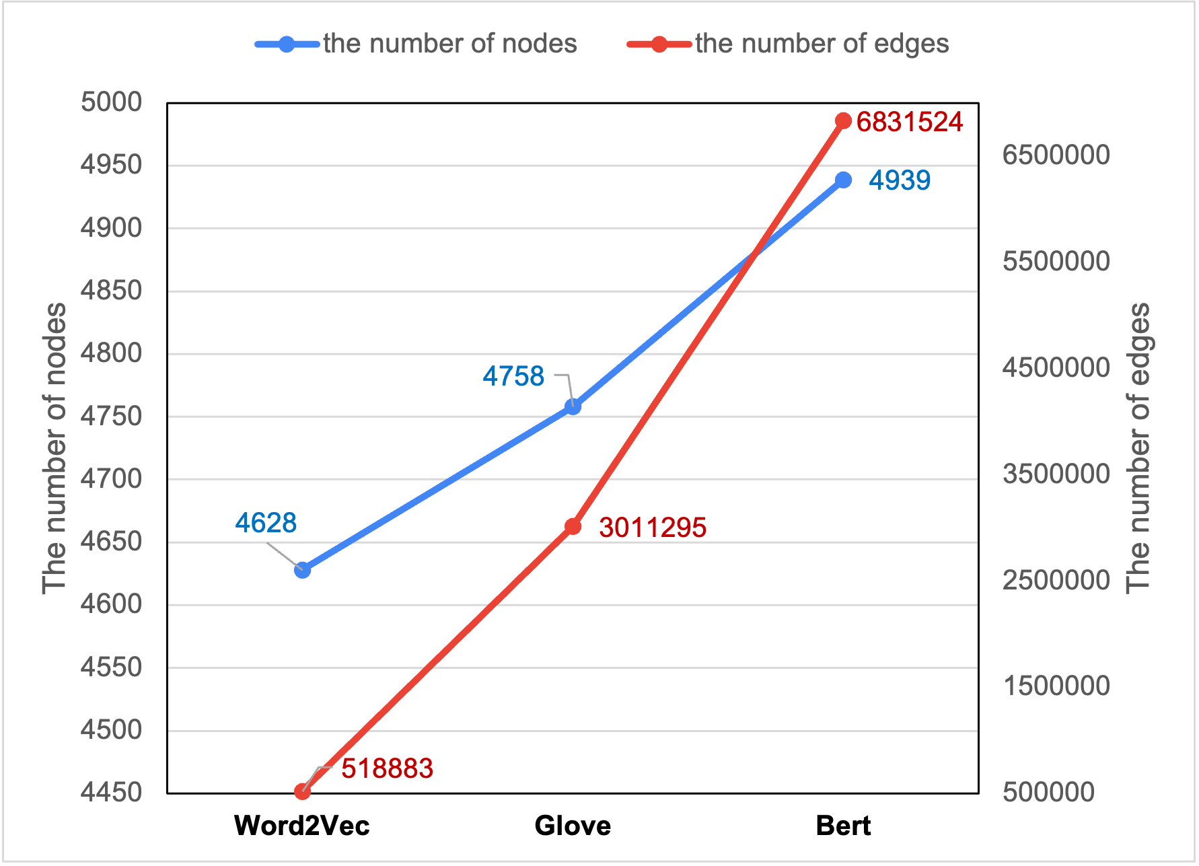
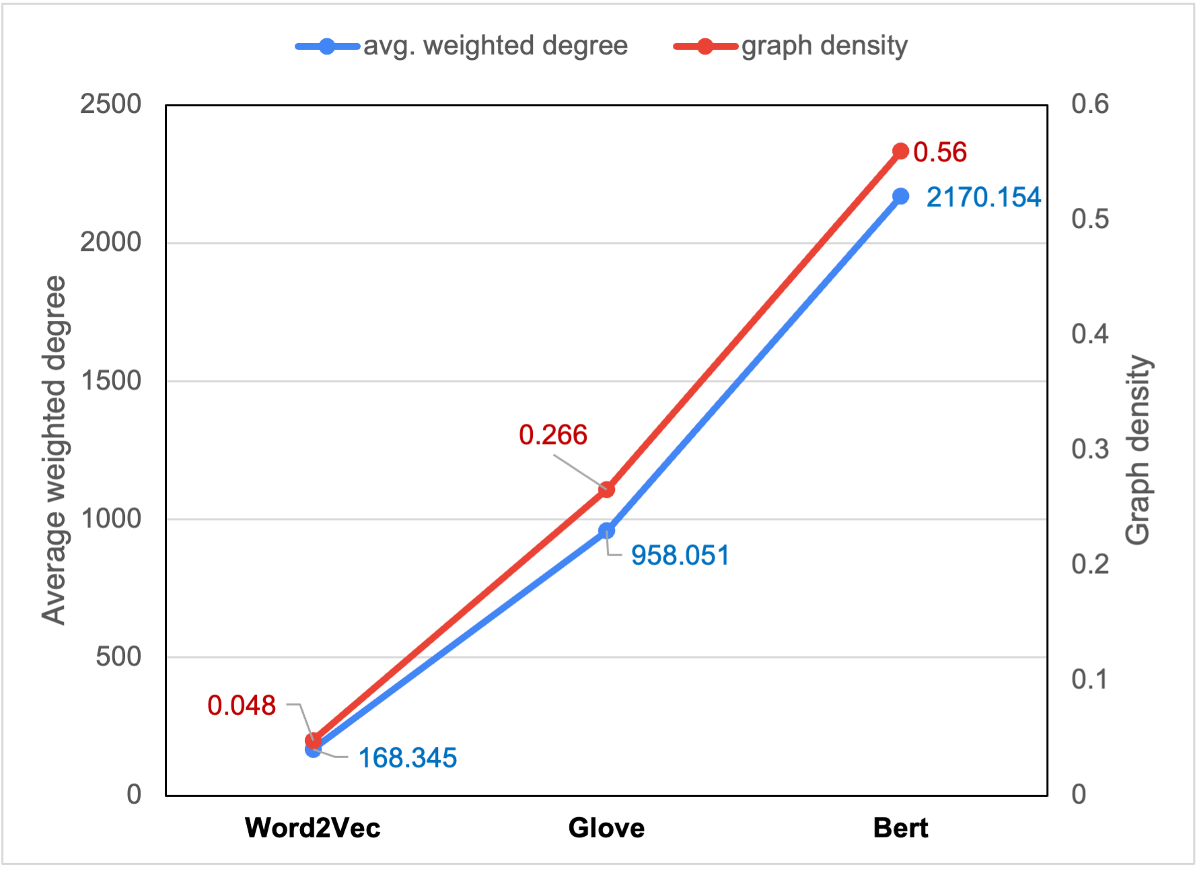
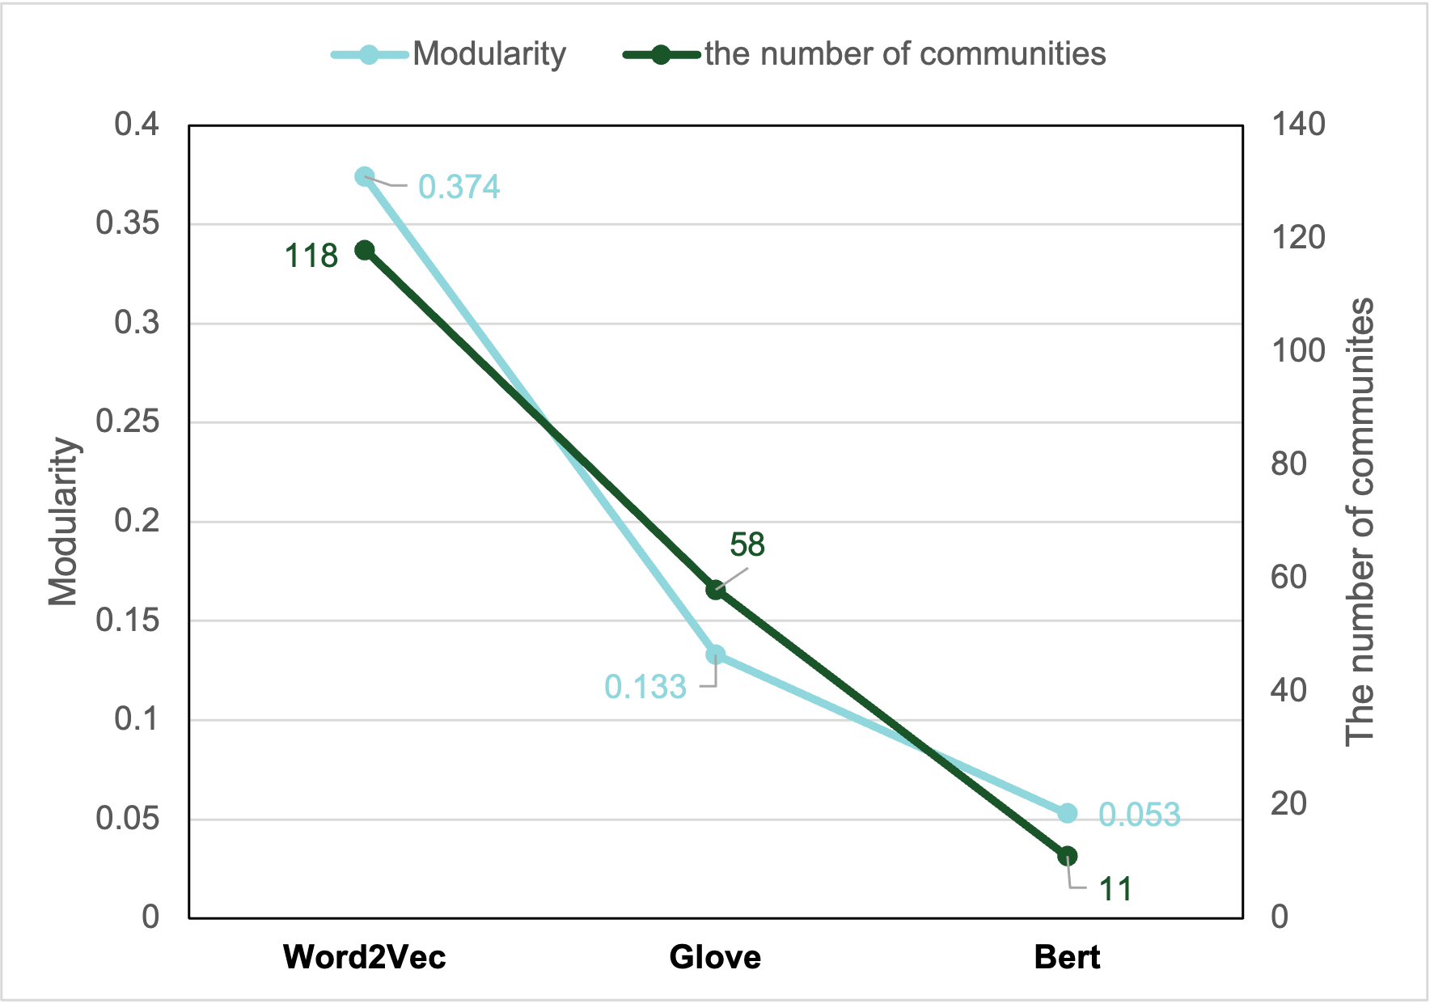
Evaluation: Comparison between algorithms
Compare graph properties
Compare community detection results
Increasing in embedding complexity leads:
More nodes and edges
Higher average weighted degree
Increased graph density
Modularity decreases
Number of detected communities decreases
BERT embedding can recognizes subtle nuances in prompts
→ finds similar prompts for 99% of prompts with similarity threshold of 0.7
Notes:
Slide 9) Compare graph properties for [word2vec, Glove, Bert] models
Line plot 1) Number of nodes, number of edges:
This plot will visually represent the number of unique entities (prompts) and their relationships for each embedding model.
As embedding complexity increases (from word2vec to Glove to Bert), we expect to see an increase in both nodes and edges.
Line plot 2) Avg. weighted degree, graph density:
This plot will show the average number of connections each node has and how many edges are in the graph compared to the maximum possible number of edges for each embedding model.
An increase in embedding complexity should lead to a higher average weighted degree and increased graph density.
Line plot 3) Modularity, Number of communities:
This plot will depict the strength of division of a network into modules and the number of distinct groups or clusters in the graph for each embedding model.
With increasing embedding complexity, modularity is expected to decrease, and the number of detected communities should also decrease.
Observation 1)
Increasing in embedding complexity leads to:
More nodes and edges.
Higher average weighted degree.
Increased graph density.
Modularity decreases.
The number of detected communities decreases.
Observation 2)
BERT embedding can recognize subtle nuances in prompts:
BERT is capable of understanding deeper meanings or nuances in prompts.
It finds similar prompts for 99% of prompts with a similarity threshold of 0.7, showcasing its efficiency and accuracy.

Slide 11

Discussion
Algorithm 2 is desirable in a case where we need to find similar prompts efficiently in terms of serendipity and novelty
Notes:
Algorithm 2 is desirable in a case where we need to find similar prompts efficiently in terms of serendipity and novelty.
Text Embedding: Algorithm 2 leverages text embedding approaches, which have been found to produce good results in generating similar prompts efficiently.
Serendipity and Novelty: The strength of Algorithm 2 lies in its ability to surprise users with unexpected yet relevant recommendations (serendipity) and introduce them to new and unique prompts (novelty).
We found that text embedding approaches produced good results, allowing for the generation of similar prompts efficiently.
When we consider a single outcome to be our goal, Algorithm-2 is the best approach in terms of serendipity and novelty.
Algorithm-3 showcases a more cohesive community structure in our evaluation.
Algorithm-3 is desirable in a use case where the desired outcome is higher relevance in the recommender system.
This can be attributed to the high modularity metric and small number of nodes of the graph associated with this algorithm.
We leave the choice to the user as a prompt recommender’s use would be conventionally targeted at creative users
and therefore, the desired goal would vary with the workflow of the user.

Slide 12
Discussion
Algorithm 3 is desirable in a case where the desired outcome is higher relevance in the recommender systems.
Notes:
Algorithm 3 is desirable in a case where the desired outcome is higher relevance in the recommender systems.
Cohesive Community Structure: Algorithm 3 showcases a more cohesive community structure, as evident from the evaluation.
Higher Relevance: The desirability of Algorithm 3 stems from its ability to offer higher relevance in the recommender system. This is attributed to its high modularity metric and the small number of nodes in its associated graph.
User-Centric: The choice of which algorithm to use is ultimately left to the user. Since prompt recommenders are conventionally targeted at creative users, the desired goal would vary based on the user's workflow.
We found that text embedding approaches produced good results, allowing for the generation of similar prompts efficiently.
When we consider a single outcome to be our goal, Algorithm-2 is the best approach in terms of serendipity and novelty.
Algorithm-3 showcases a more cohesive community structure in our evaluation.
Algorithm-3 is desirable in a use case where the desired outcome is higher relevance in the recommender system.
This can be attributed to the high modularity metric and small number of nodes of the graph associated with this algorithm.
We leave the choice to the user as a prompt recommender’s use would be conventionally targeted at creative users
and therefore, the desired goal would vary with the workflow of the user.

Slide 13

Thank you
Kapil Wanaskar
Software (Machine Learning) Co-op Intern,
at Product Security Team,
Intuitive, Sunnyvale

